Slide 1

Adding Audio Files to CodeX
An extension for Mission 5

Slide 2
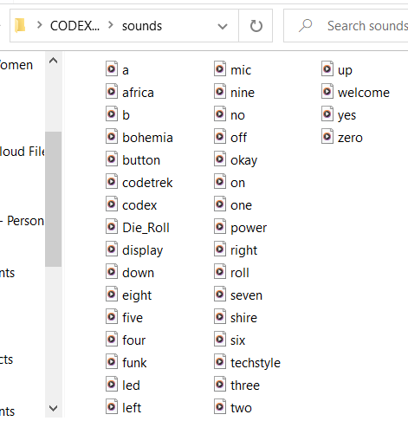
Audio Files on CodeX
CodeX comes with many sounds pre-loaded on its memory. You can see the files from the CodeX drive.

Slide 3
Audio Files on CodeX
You can add audio files to your CodeX folder.
The files are loaded onto the CodeX memory. So you will need to use the same CodeX every time if you load files on it.
The audio files must be in MP3 format.

Slide 4
Adding Audio Files : Step 1
Find an audio file to add.
The file must be an MP3.
Download the file (or create an audio file).
  Here are some websites you can use:
  https://pixabay.com/sound-effects/
  https://pixabay.com/music/
If you want to create your own audio file, watch the YouTube video

Slide 5
Adding Audio Files : Step 2
Put your CodeX in USB-writable mode.
Make sure your CodeX is connected to your computer.
Press and hold the L and A buttons.
While holding them, press and release the reset button on the back.
(see next slide)

Slide 6
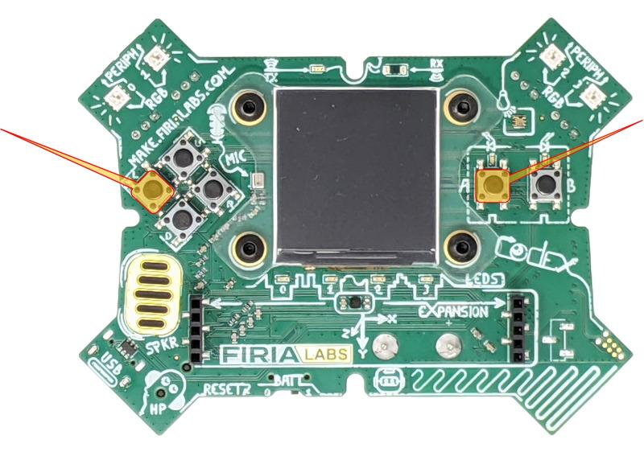
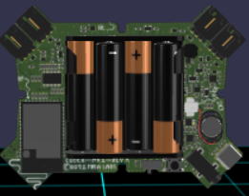
Adding Audio Files : Step 2
L and A buttons
Reset button
youtube video demonstration

Slide 7
Adding Audio Files : Step 2
The red LEDs under the
screen will light up one at
a time, starting with LED 3.
Then you will see a
double-flash of ALL red LEDs
under the screen.
This confirms the filesystem is in USB-writable mode.
Release the L and A buttons.

Slide 8
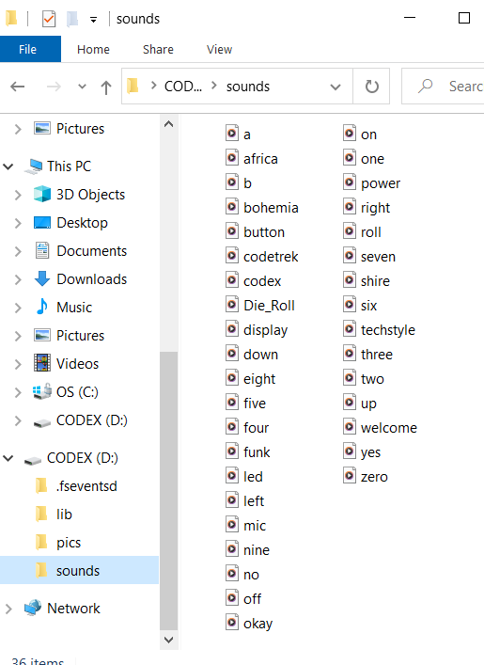
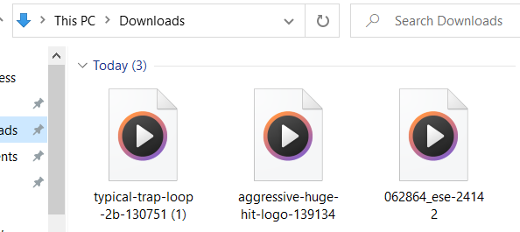
Adding Audio Files : Step 3
Upload your audio files to the CodeX sound folder.
Open the CodeX folder.
Open the sounds folder.
Drag the audio files you want to
add into the sounds folder.

Slide 9

Adding Audio Files : Step 4
Make the CodeX read-only again.
Disconnect the CodeX from the computer.
Connect CodeX again.
Use the audio commands you learned to play the audio files added to the CodeX sound folder.
Audio file name here

